Slide 1

Capstone project – Segment 2
Cheryl berger • Lucien Roberts • martha richardson

Slide 2

Agenda
Topic Selection
Data Exploration
Objectives
Assumptions
Data Pre-processing
Data Cleaning
Feature Selection & Engineering
Salary Levels
Regions
Analysis of Machine Learning Models
Linear Regression
Ensemble ML Model
Model Assessment & Selection (Limitations & Benefits)
Data Interface to Dashboard
Pandas and Python to connect model
Tableau Storyboard/Website configuration
Demonstration
Overall Salary Range Predictor
Top 5 Tech Salary Predictor
Conclusions
Data Summary
Predictive Model Summary
Discussion/Q&A
Unsupervised Learning

Slide 3
Data SElection

Slide 4



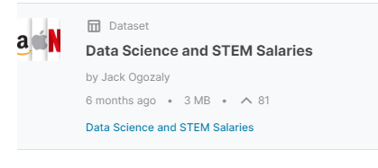


Our project
Kaggle Data Science and STEM Salaries Dataset

Slide 5
Why choose this dataset?
It is extremely relevant to all of us
The dataset pretty large, needs some pre-processing, but is not so big that we have trouble storing and sharing it
There are several columns in the data we can target for different types of analysis

Slide 6
Description of dataset
29 Columns and 62,642 rows
Data Science and STEM Salaries from June 7, 2017 to August 17, 2021
https://www.kaggle.com/datasets/jackogozaly/data-science-and-stem-salaries
Demographics – Gender, race, location, education level
Salary Details – Base and total annual salaries, bonus &/or stock option values
Employment - Company name, years of experience and years at employer

Slide 7
DATA EXPLORATION

Slide 8
Data Exploration
Explore the data for predictive features
Note the continuous vs categorical values
Evaluate the distribution of the data for various features
Identify opportunities for data cleaning
Capstone Project - Tableau Vizs

Slide 9
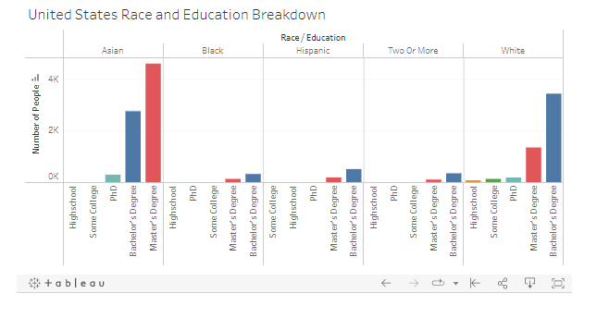
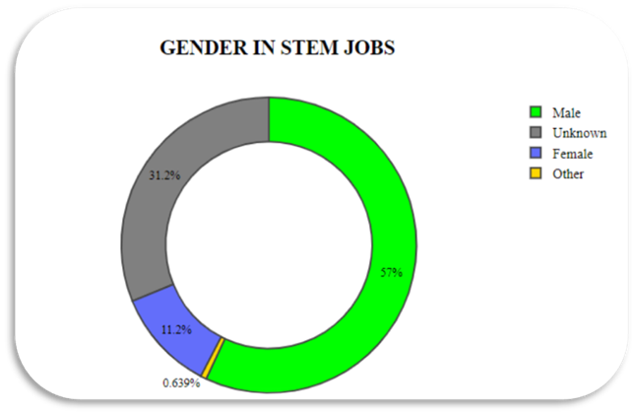
DEMOGRAPHICS oF RESPONDENTS

Slide 10
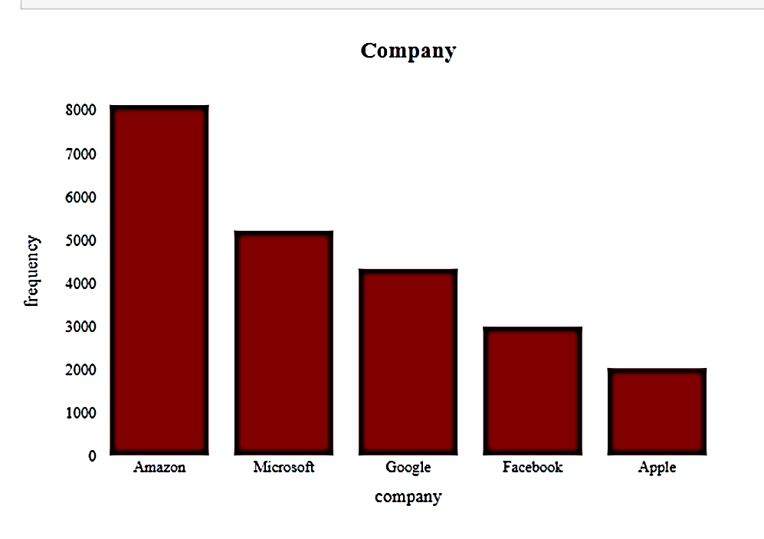
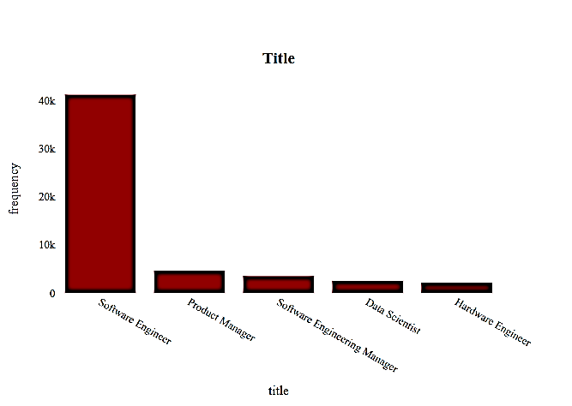
TOP 5 EMPLOYERS And TITLES

Slide 11
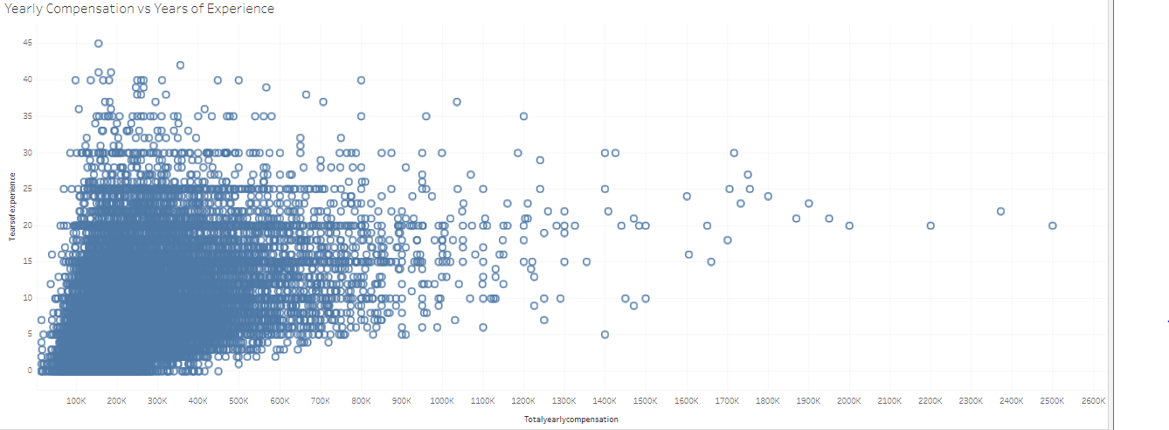
AnnuAL SALARY BY YEARS OF EXPERIENCE

Slide 12
OBJECTIVES OF OUR PROJECT
Discover what features and model make the best predictions for salaries of STEM Professionals and Data Scientists using various ML models
Explore the data and visualize contents, perform data cleaning, engineer the features, and pre-process the dataset for machine learning
Identify the best predictive model and select the user input features.
Apply the model to the dataset to create an interactive tool to predict salary range for Data Science and STEM Professionals.
Create a dashboard using Tableau Public and share on the www using Heriko.

Slide 13
PROJECT ARCHITECTURE
Data
Identify & Select the Dataset
Model
Build the Random Forest Classification Model
Train the model using our pre-processed data
Visualize
Publish to the web using Heroku app
Include the dashboard with our tool contain visualizations of the data
Identify features to assemble the best predictive model
Use the model to predict salary ranges and/or salary level after entering required inputs
Establish Objectives & Assumptions
Explore Features using Python, Pandas dataFrames
Pre-process the Data for Supervised - Ensemble Learning
Evaluate the models’ performance
Perform Data Cleaning
Create visualization in Tableau or with Python plotting libraries such MatPlot from NumPy arrays
Export the Model from Python file
Create Config file (app.py) & Import Model
Write the function to deploy the cleaned dataset to the model to create the predictive tool

Slide 14
KEY ASSUMPTIONS
The methods to gather the data appear to be user survey and do not represent a random sample of the full population of Data Science and STEM professionals.
Data was collected over a 5-year duration, all salary values used for modeling were weighted equally.
Currency units were not given discreetly, data was filtered for US respondents and assumes salary values are reported in US dollars.
There is no uniform standard for job titles across industries, or even similar companies, ladders and levels are not considered in our analysis.

Slide 15
DATA PRE-PRocessing

Slide 16
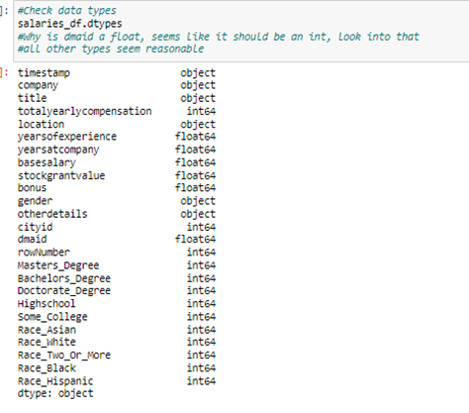
DATA CLEANING STEPS
1. Identify & Reduce noisy data:
Use Pandas DataFrames to evaluate data for usable variables
Split & Transform Variables such as Location & TimeStamp
Perform Outliers Analysis & Visualize with MatPlotLib tools
2. Locate and Remove Missing data
3. Identify and Correct Ambiguous Data
4. Load Dependencies to complete analysis
from datetime import datetime
from sklearn.linear_model import LinearRegression
from sklearn.preprocessing import OneHotEncoder
from scipy import stats

Slide 17
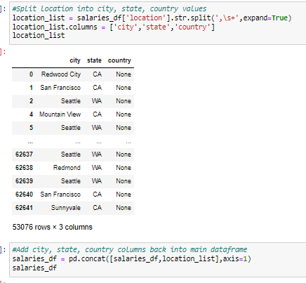
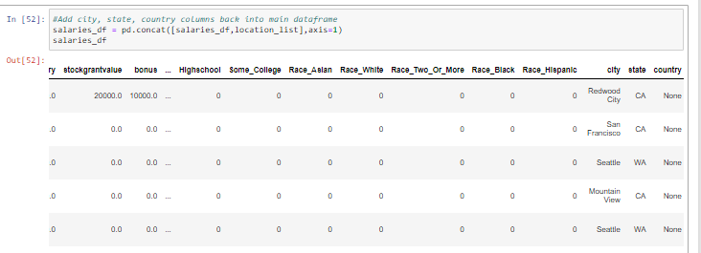
SPLIT the LOCATION COLUMN
The feature “location” was an object containing a string list of city, state & country
Using Python, split into 3 columns and add back to the Pandas dataFrame

Slide 18
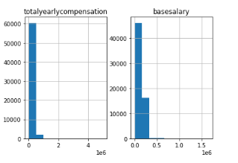
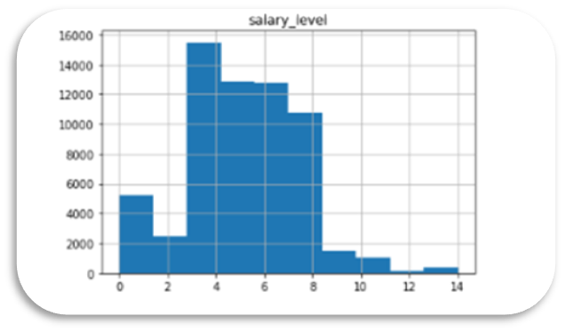
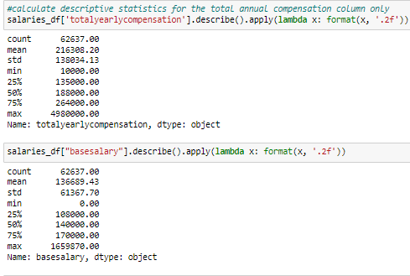
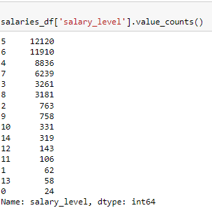
CLEANING Noisy & UNWANTED DATA
Total & Base Salary BEFORE
Salary Levels Counts AFTER

Slide 19
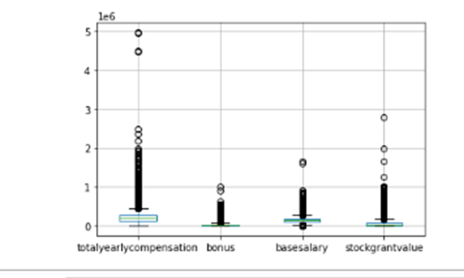
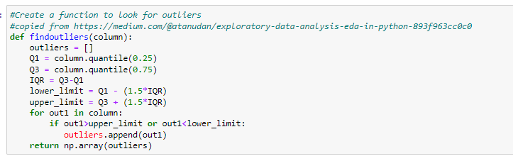
ANALYZE OUTPUT DATA FOR OUTLIERS
4 features related to salary
Base, Total annual, Bonus and Stock
Use Numpy & Matplot lib to generate box plots
Drop Outliers from Dataset
Add def. of outliers here
Write the clean data to file
New Dataset contains 53,076 rows × 25 columns
Resources/Cleaned_Salary_Data.csv
Column Name | # Outliers | % of Total
Total Yearly Compensation | 3133 | 5.00
Base Salary | 2155 | 3.44
Stock Grant Value | 4683 | 7.48
Bonus | 2604 | 4.16

Slide 20
PERFORM ADDITIONAL Data Cleaning
0 duplicate columns/rows found in dataset
Drop 4 unwanted columns 'level’, 'tag’ 'Race’, 'Education'
Identify & Remove null values
gender 19,540
otherdetails 22,505
Drop 5 rows where company is NaN missing rows (data now has 62,637 rows)
Convert timestamp field from object to ‘datetime’
Clean-up erroneous data values in location, education and gender columns
The total number of rows with data in the education columns is 30,472
The total number of rows with data in the race columns is 22,426
Identified and corrected additional typographical and formatting errors in the location data

Slide 21
MACHINE LEARNING MODEL

Slide 22
Initial Proposed machine learning model
Our goal is to deploy a machine learning model that can be used to predict salaries for data scientists and STEM professionals.
Linear regression seemed to be best model to choose with a continuous variable like salary.
With our cleaned and pre-processed data, we divided the data into training and testing sets and then train and test our model
The salary prediction by years of service example in Module 17.2.3 was the starting point for our coding
We explored which features were the best predictors

Slide 23
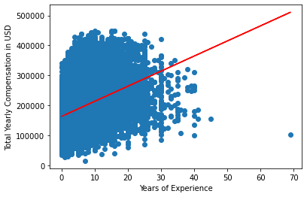
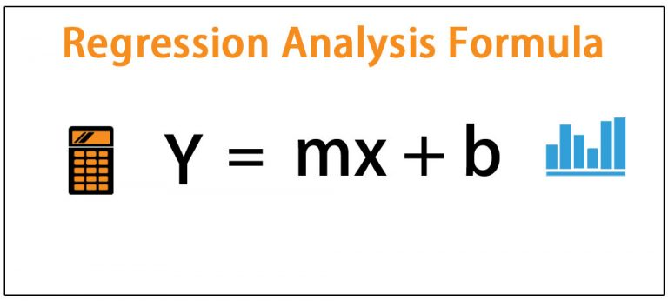
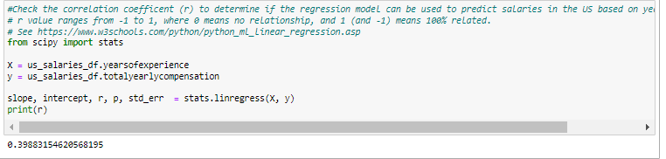
Linear RegRession – Years of Experience
Resources/US_Salary_Cleaned.csv
from sklearn.linear_model import LinearRegression
from scipy import stats
Total Salary by Years of Experience
r = 0.40 (correlation coefficient)
A modest correlation, this model could use improvement
Cleaning_Data.ipynb
See https://www.w3schools.com/python/python_ml_linear_regression.asp
Notes:
Slope and intercept don’t add much to interpretation. Medium strength correlation at best, aiming for =/>0.5

Slide 24
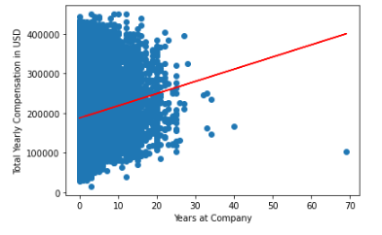
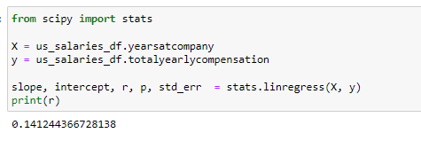
LINEAR REGRESSION – YEARS AT COMPANY
Total salary by Years at Company
Slope = [3086.77]
Intercept I = 187505.03
r= 0.14
Weaker correlation for predictive model
Correlation was not improved when base salary was used as output for either yrs. of exp. or yrs. at company

Slide 25
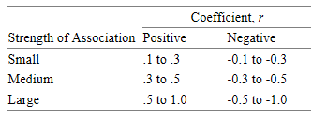
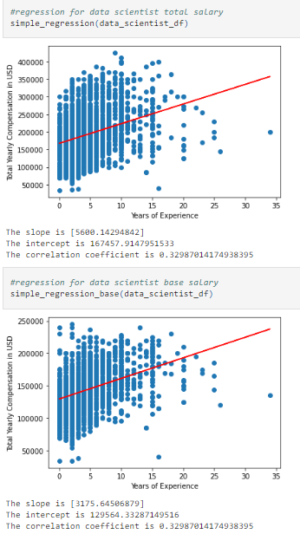
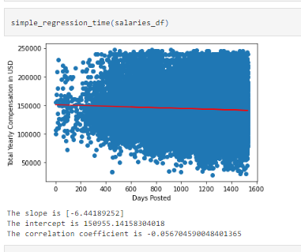
Other Regression FEATURES EXPLORED
Job Title (r=0.33)
Date Entered (r< -0.1)
Goal r= 0.5 or higher
Linear Regression models exhibited a low to medium correlation coefficient (r) and a at best a medium strength of association
Years of experience and years at company were stronger predictors for the liner regression model when limited to job title or company.

Slide 26
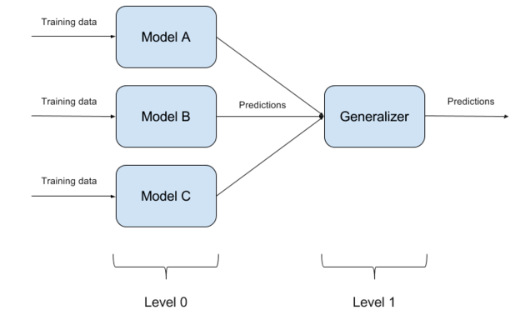
SUPERVISED LEARNING – ENSEMBLE LEARNING
Regressions models are constrained to continuous variables while Ensemble Learning models use categorical variables
IMPORT & SET-UP SCIKIT LEARN ML TOOLS
from sklearn.preprocessing import OneHotEncoder
from sklearn.ensemble import RandomForestClassifier
from sklearn.model_selection import train_test_split
from sklearn.preprocessing import StandardScaler
from scipy import stats
from datetime import datetime
from sklearn.metrics import accuracy_score, confusion_matrix, classification_report
Preprocessing for Other Models.ipynb

Slide 27

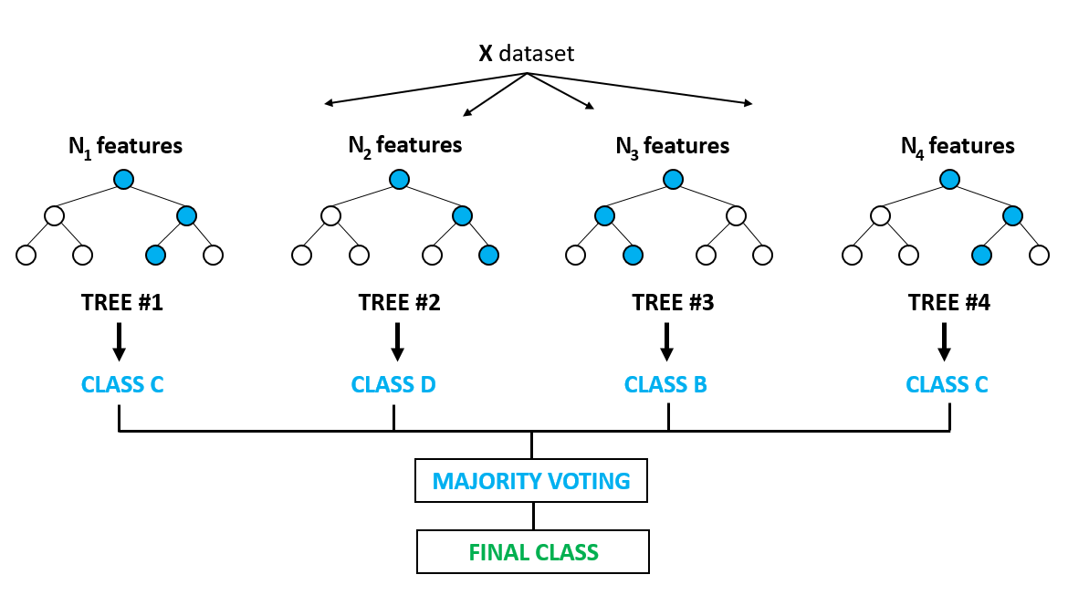
RANDOM FOREST MODEL (RFM)
Random Forest Models are used primarily for classifications problems but can be used for regression as well
Algorithm creates decision trees on data samples and then gets the prediction from each of them and finally selects the best solution by means of voting.
More trees mean more robust forest
Reduces over-fitting by averaging the result
Cleaned_Salary_Data.csv
Notes:
Random forest is a supervised ensemble learning algorithm that is used for both classifications as well as regression problems. But however, it is mainly used for classification problems.
As we know that a forest is made up of trees and more trees mean more robust forest. Similarly, the random forest algorithm creates decision trees on data samples and then gets the prediction from each of them and finally selects the best solution by means of voting. It is an ensemble method that is better than a single decision tree because it reduces the over-fitting by averaging the result.

Slide 28
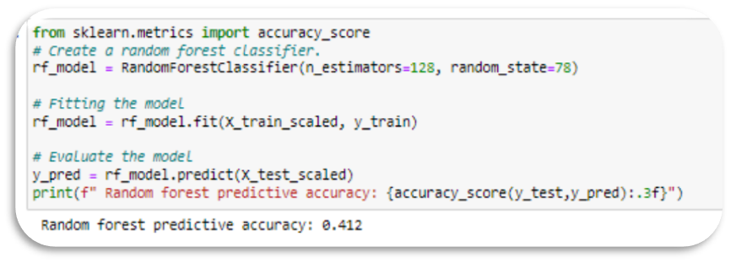
create the RANDOM FOREST MODEL – ALL FEATURES
PERFORM CLASSIFICATION OF THE DATA – ALL FEATURES
DROP OUTPUT COLUMNS
DEPLOY ONE HOT ENCODING
SCALE USING STANDARD SCALER
SPLIT INTO TEST/TRAINING DATASETS
Training Data Shape (46977 rows, 38 columns)
Test Data (15660 rows, 38 columns)
n=15 FEATURES

Slide 29
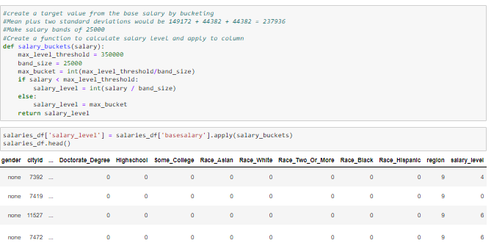
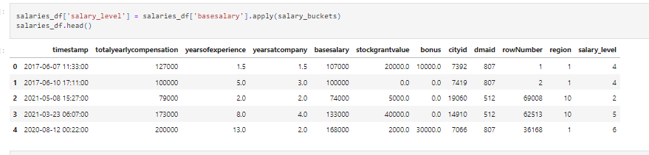
FEATURE ENGINEERING – Salary level
For rows where basesalary = 0, set equal to totalyearlycompensation
Assign a target value from the base salary by bucketing
Mean + 2SD =
149,172 + 2(44,382) = $237,936
Max. salary = $350, 000
Create a function to generate salary levels using salary bands of $25,000 for a total of 15 salary levels

Slide 30
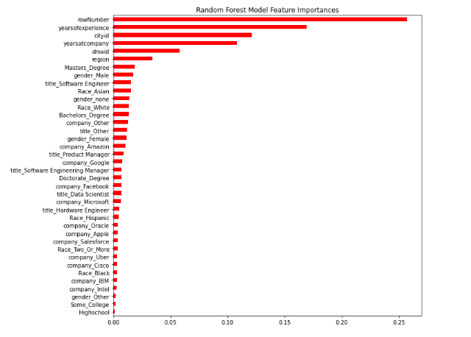
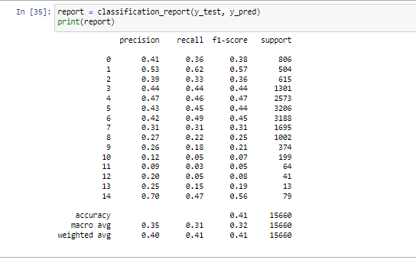
OUTCOMES & IMPORTANCES – RFM ALL FEATURES
Predictive Accuracy = 0.41
All F1 Scores < 0.50

Slide 31
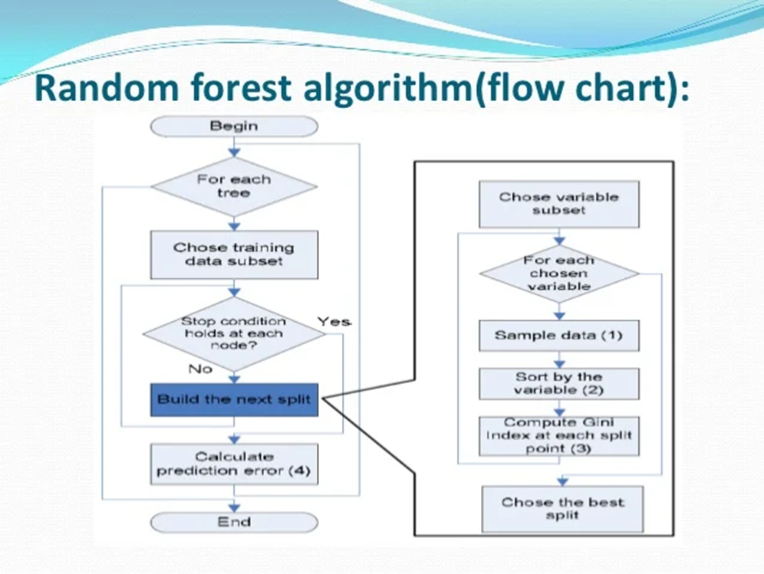
FINAL MODEL SELECTION
ENGINEER THE REGION FEATURE
RE-CLASSIFICATION OF THE DATA
DROP ALL FEATURES EXCEPT
Years of Experience
Years at Job
Region
DROP OUTPUT COLUMS
DEPLOY ONE HOT ENCODING
SCALE USING STANDARD SCALER
SPLIT INTO TEST/TRAINING DATASETS
Training Data Shape (46,977 rows, 3 columns)
Test Data (15,660 rows, 3 columns)
Final_model_random_forests.ipynb

Slide 32
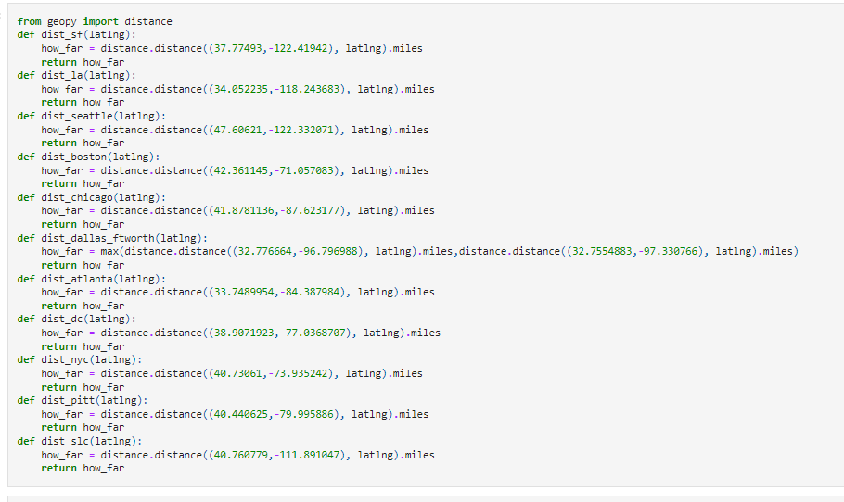
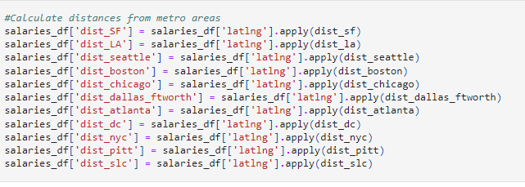
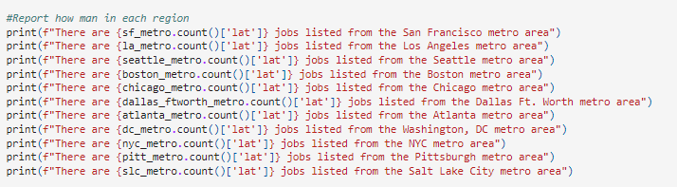
FEATURE ENGINEERING - REGION
Look at each metro area and calculate the distances from downtown and include participants within 30-50 miles.
Start by naming & retrieving long/lat for each metro area
Use an openweathermap API call to get the long and lat for each city and state combination
Create a loc group for each of the top 9 regions
For each region, calculate the distance from the central metro
Use this distance to decide who to include in that region, be consistent if it makes sense to
Notes:
Avoid geographical overlap any of the identified regions
Respondents not captured in the top 9 regions are grouped into region 10.

Slide 33
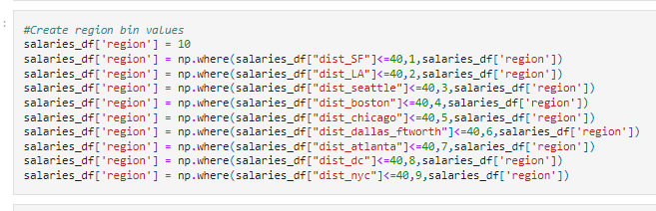
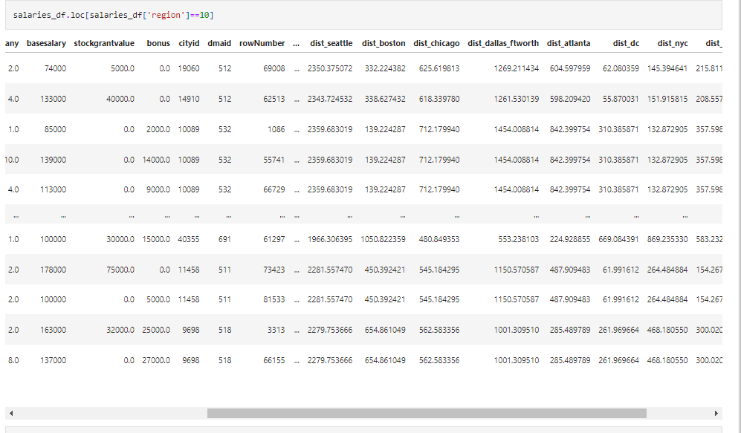
FEATURE ENGINEERING – BinNING REGION
Create the Region Bins by establishing distances of <=40miles from the metro center.
Allow Region 10 to include all other locations
A total of 10 regions are generated
Region 10 contains 9976 rows

Slide 34
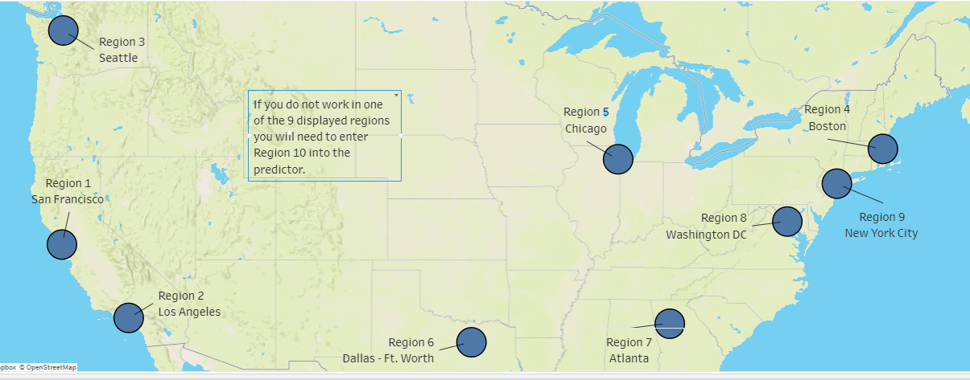
US RegioNS

Slide 35
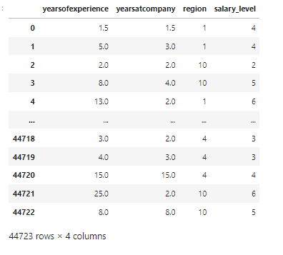
FINAL DATA PREpARATION
Load the Preprocessed data:
Resources/US_Salary_Preprocessed_new_regions.csv
44,723 rows × 29 columns
Drop features that don't contribute much to model:
Company Job title Gender
Race Education dmaid cityid rowNumber timestamp
DataFrame (salaries_df) contains
Years of Experience, Years at company, Region and Salary Level
44, 723 rows but only 4 columns
Remove output from features data:
y = salaries_df.salary_level
X = salaries_df.drop(columns=['salary_level'])
View the new DataFrame in Pandas

Slide 36
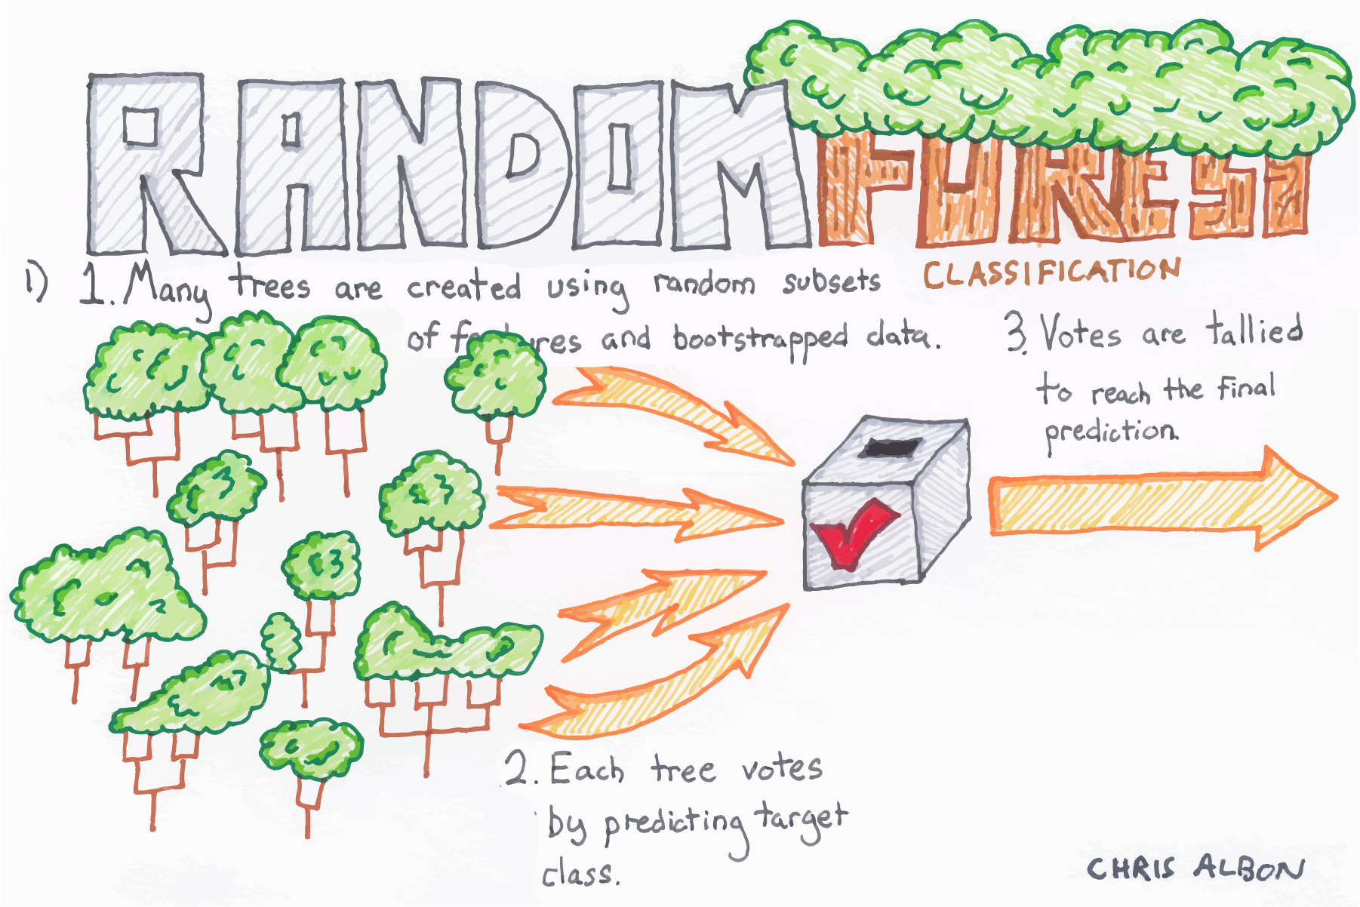
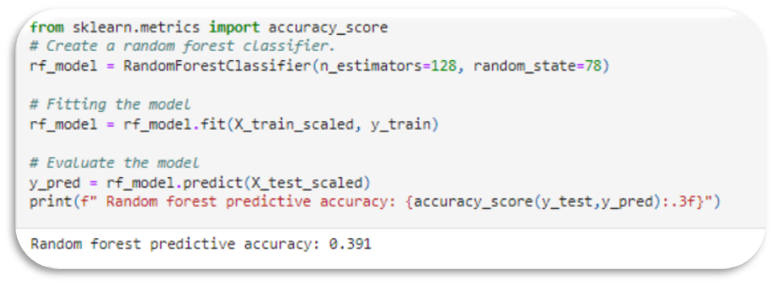
RANDOM FOREST MODEL – 3 FEATURES
Resources/US_Salary_Preprocessed_new_regions.csv"
Training Data Shape = 33,542 rows, 3 columns
Test Data Shape = 11,181 rows, 3 columns

Slide 37
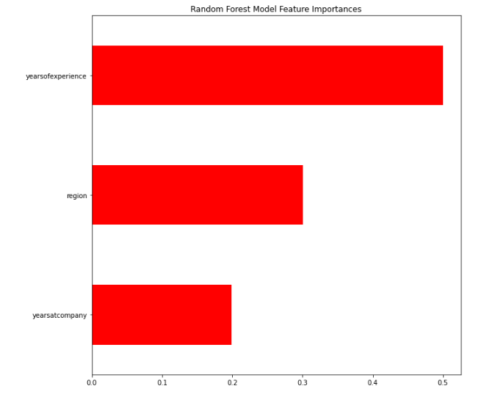
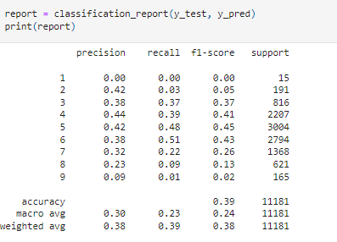
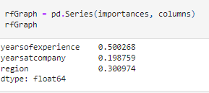
OUTCOMES & IMPORTANCES – RFM 3 FEATURES
Predictive Accuracy = 0.391

Slide 38

MACHINE LEARNING MODEL SELECTION
BENEFITS
Classification Models allows for the use of several features to optimize output
We can use both continuous and categorical features for this model
Our primary objective is to predict a salary range +/- 25K/yr. some error is reasonable to expect
Classification models provide a superior method for working with missing data
Many of the categorical features of our data contain missing data
By grouping salaries into ranges and binning the regions for respondents, the noise in the data is reduced
DRAWBACKS
When the data contain groups of correlated features of similar relevance for the output, then smaller groups are favored over larger groups
We seek to overcome this by selecting features that appear to be the largest contributors to predicting salaries
Decision trees run the risk of overfitting as they tend to tightly fit all the samples within training data, Random Forest Classification has the least risk of overfitting.
This model appears to lack sensitivity as recall & F1 scores were generally less than 0.5

Slide 39
Connecting to the salary PREDICTION TOOL

Slide 40
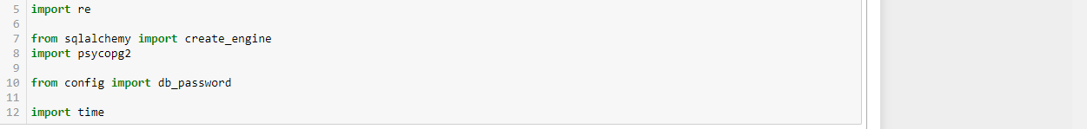
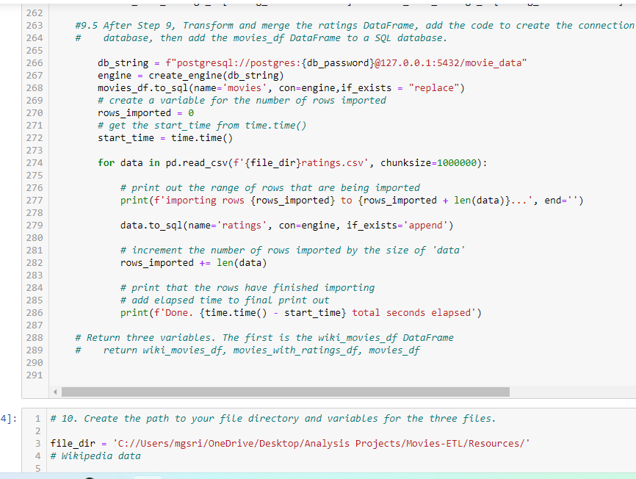
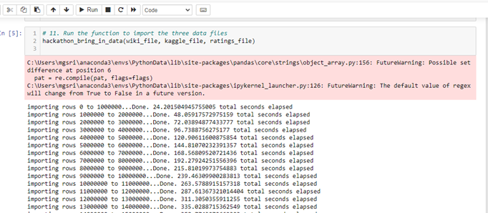
Connecting to the DaSHBOARD
Import dependencies
Create Config file (app.py) & Import Model
Export the Model from Python file
Write the function to import the cleaned and preprocessed datafile
Create the HTML file and use HERIKO to connect to Tableau Dashboard

Slide 41
DEMONSTRATION
https://stem-salary-predictor.herokuapp.com/

Slide 42
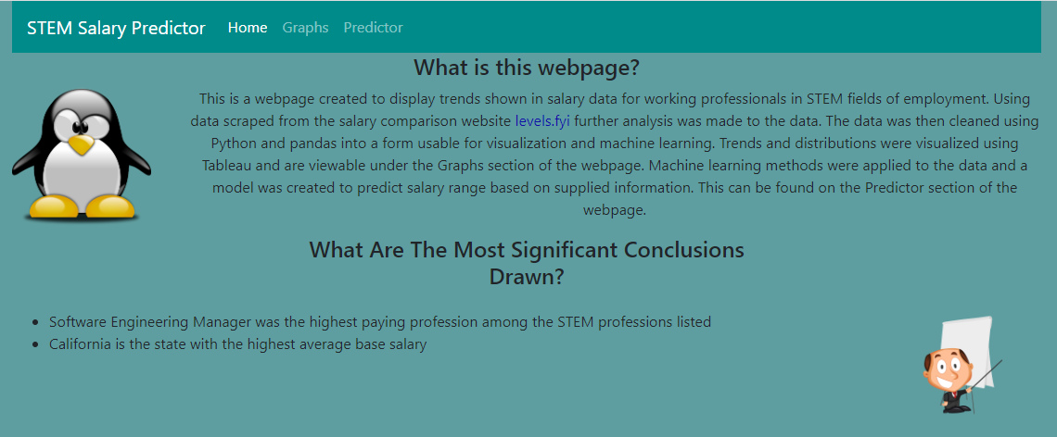
STEM SALARY RANGE PREDICTOR
https://github.com/mgsrichard/Capstone-Project/blob/main/rf_model_pkl

Slide 43
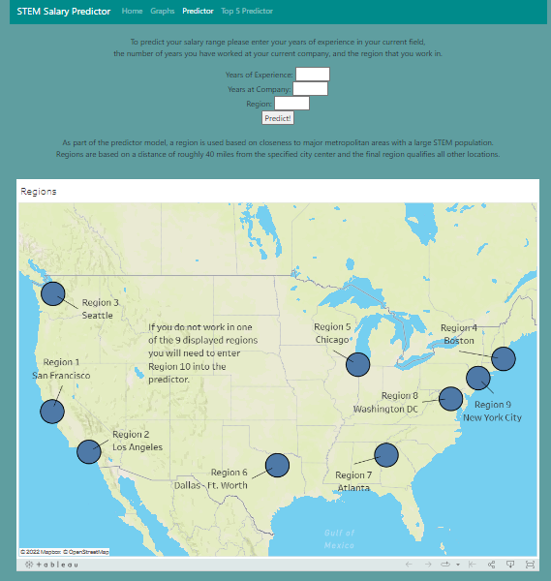
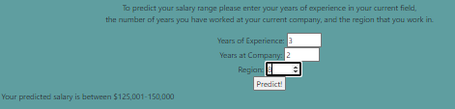
PreDICTION TOOL
Example:
Data Science and STEM professionals living in the DC area with 3yrs exp. and 3yrs at the company can expect a salary range of $125,000 – $150,000 annually

Slide 44
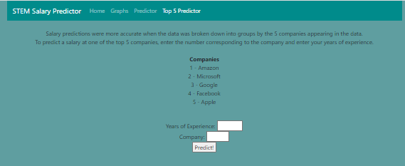
Top 5 Tech Salary Predictor

Slide 45

CONCLUSIONS

Slide 46



DATA SUMMARY
California is the state with the highest average base salary ($161,393)
Of the 15 tiles reported, Software Engineering Managers earned the highest average salary of $185,658 annually
79% of respondents were employed in the top 9 regions.
Of 1631 total companies, 35% of the responses were represented by the top 5 employers: Amazon, Apple, Facebook, Google and Microsoft

Slide 47


DATA SUMMARY
Only 36% reported race, of them 52% identified as Asian
Only 49% reported Education Level, of them 51% had a Masters Degree
The gender variable was confusing:
19,540 (31%) respondents did not report gender
35,698 (XX%) of respondents identified as male
Notes:
Demographic data was somewhat skewed, even after cleaning due to lack of responses or perhaps the population of Data Science and STEM Professionals represented by the data sample collected during scraping.

Slide 48

PREDICTING DATA SCIENCE & STEM SALARIES
The data was noisy, often incomplete for some variables causing some analysis to be impossible.
Data was clustered in certain geographical areas and needed considerable engineering to be useable.
The presumed linear relationship between salary and years of experience was not as closely correlated as expected, r=0.39.
The model we chose for our salary range prediction tool:
Random Forest Model
Predictive Accuracy is slightly >39%
Notes:
Efforts to improve the RF Model by dropping features that provided little influence to the model did not improve accuracy over the full featured model and showed no improvement in accuracy over the linear regression model. As the tool predicts a salary range and the user is prompted to enter values for 3 features, predictive accuracy is based on determinations developed by training the tool using the static data rather than applying regression statistics with weak correlations, thereby reducing any bias toward a linear relationship of these features to the output.

Slide 49

Discussion

Slide 50


UNSUPERVISED LEARNING
Using the K-means algorithm, an elbow curve and a silhouette analysis, we determined that it was reasonable to divide the data into 7 clusters, which differed by base salary amount, years of experience, and location.
Classes 1 and 6 tend to be low pay, low experience, and outside the top 9 tech areas
Class 4 is medium pay, medium experience, and had many from the DC metro
Class 5 is medium pay and longer experience, mostly outside top 9 tech areas
Classes 0, 2, and 3 tend to be higher paid and medium experience, with many from class 0 in the NYC metro, many from class 2 in the San Francisco metro, and many from Class 3 from the Seattle metro

Slide 51



Neural Network (NN) model
The NN model was the least successful model
The highest accuracy observed =1.4%, using the Keras tuner with many different configurations of parameters

Slide 52


Top 5 companies
Amazon, Facebook, Microsoft, Google, and Apple accounted for 35% of all jobs listed
The best accuracy for salary prediction used the linear regression model on each company’s data individually, with Microsoft > 60% accuracy
Salary for 1yr. exp at Google = $136,089!

Slide 53

QUESTIONS?

